Slide 1
United Airlines Holdings Analysis
David Brehm

Slide 2

United Airlines Fatalities
Despite already having a much lower fatality rate than automobiles, United Airlines fatalities are an even smaller minority of the overall airplane fatalities.
The rate of 1.46 fatalities per 100M KM traveled is 99.5% less than the automobile rate of 3142.60.

Slide 3
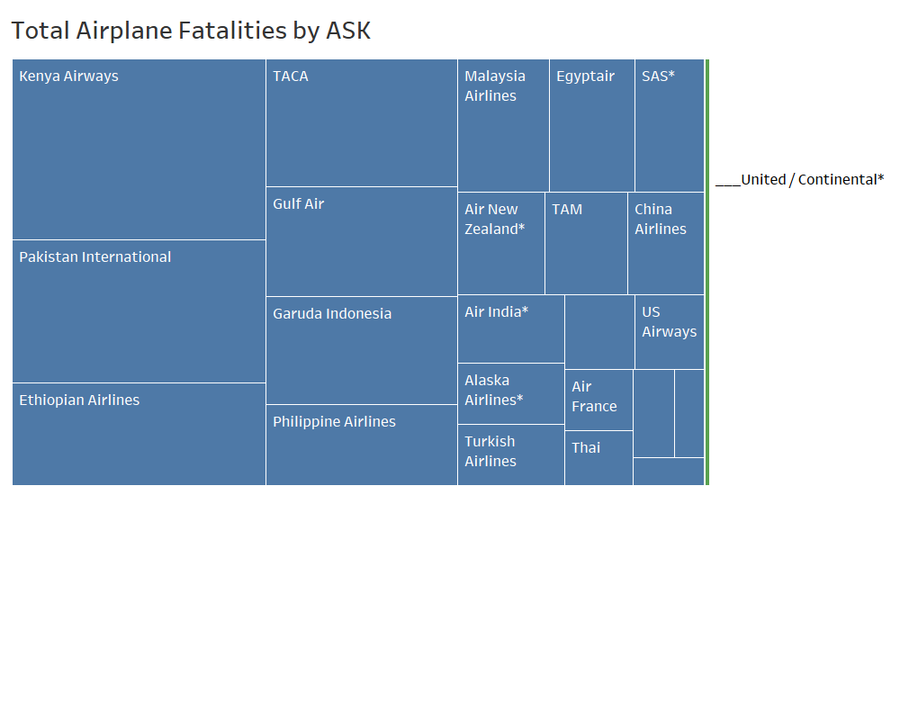
Overall Airline Fatalities
International airlines with major accidents while having fewer total kilometers traveled contributed to most of the airplane fatality rate.
The green sliver is how United aligns proportionally.

Slide 4
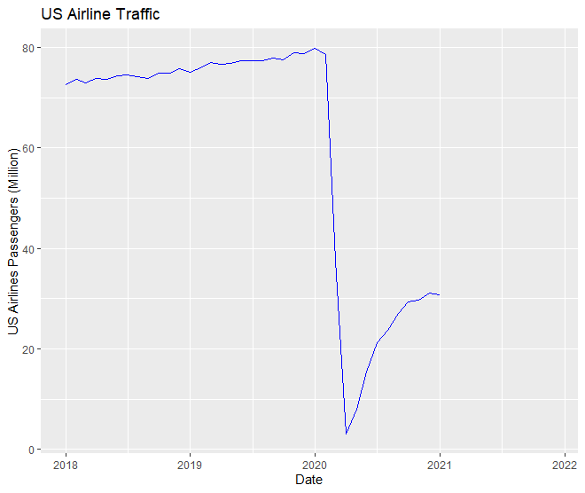
US Travel Demands
US Airline passengers had been slowly increasing until the COVID-19 pandemic.
Monthly passengers reached a minimum of 2.99 million in April 2020. Since that point, demand has slowly risen.

Slide 5
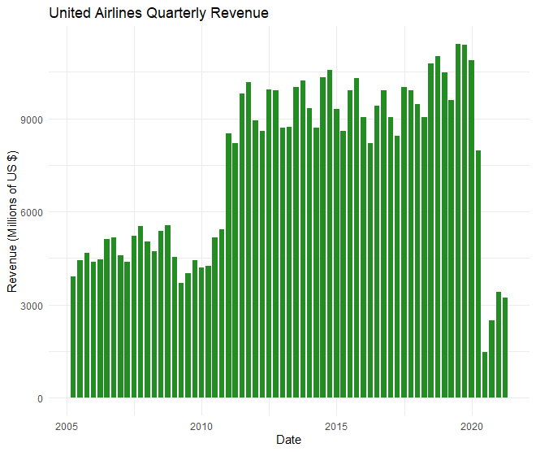
Financial Status
Similar to the overall US travel demands, United Airlines quarterly revenue was slowly increasing through late-2019 until the pandemic.
The quarterly revenue has increased from its minimum in Q2 2020.

Slide 6
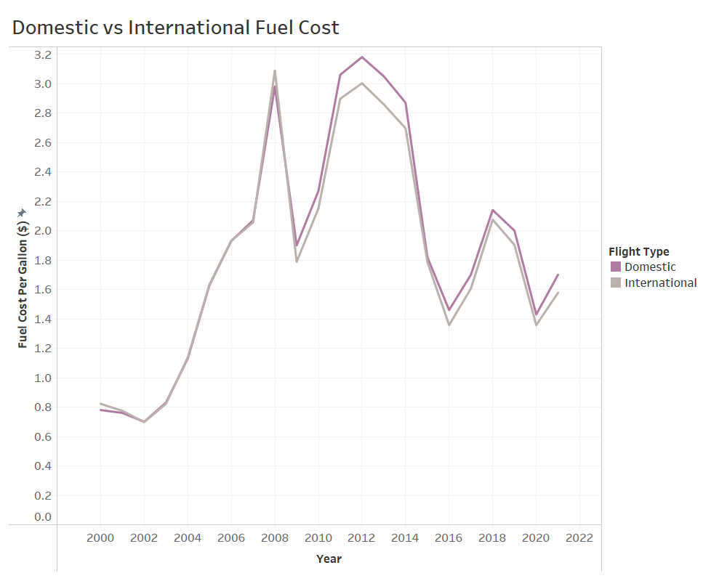
Financial Planning – Fuel Costs
For future flight planning, there is a small but existing difference in fuel costs for US airlines between domestic and international flights.
The most recent numbers are:
Domestic: $1.70/gal
International: $1.65/gal

Slide 7
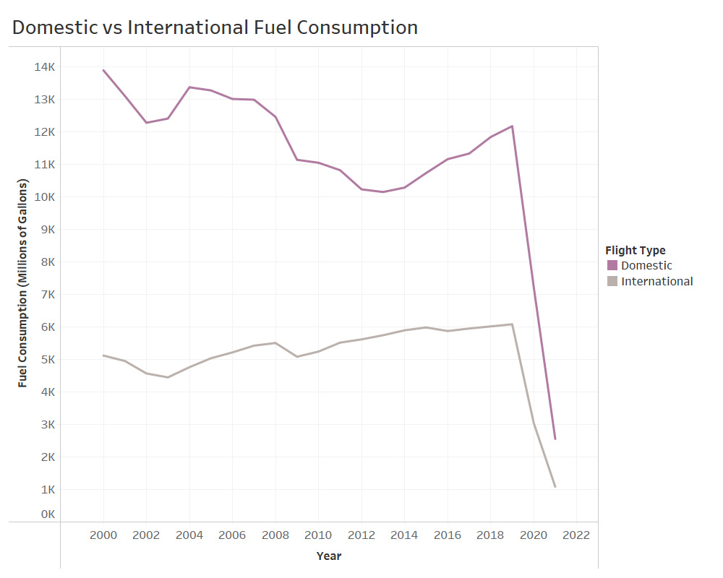
Financial Planning – Flight Allocation
With the slight advantage in fuel costs for international flights, it could be beneficial for US airlines to add more international flights.
Much more fuel is consumed domestically than internationally. The most recent numbers for 2021 are:
Domestic: 2558.1 M gallons
International: 1085.9 M gallons

